Slide 1
CS5351 2025/26 Modern Code Review
Dr W.K. Chan
Department of Computer Science
Email: wkchan@cityu.edu.hk
Website: http://www.cs.cityu.edu.hk/~wkchan

Slide 2
Outline
What is Code Review?
Why do we do it?
Code Inspection
Modern Code Review
Background readings
https://en.wikipedia.org/wiki/Fagan_inspection
https://ieeexplore.ieee.org/document/6606617/
downloadable when connecting to the campus network
Try a code review tool by a group of students (Ex MCR-2)

Slide 3
What is Code Review
Performing human inspection on the source code by developers other than the author of the code.
is a well-established software engineering practice
aim at maintaining and promoting source code quality, as well as sustaining the development community by means of knowledge transfer of design and implementation solutions applied by others [12]

Slide 4
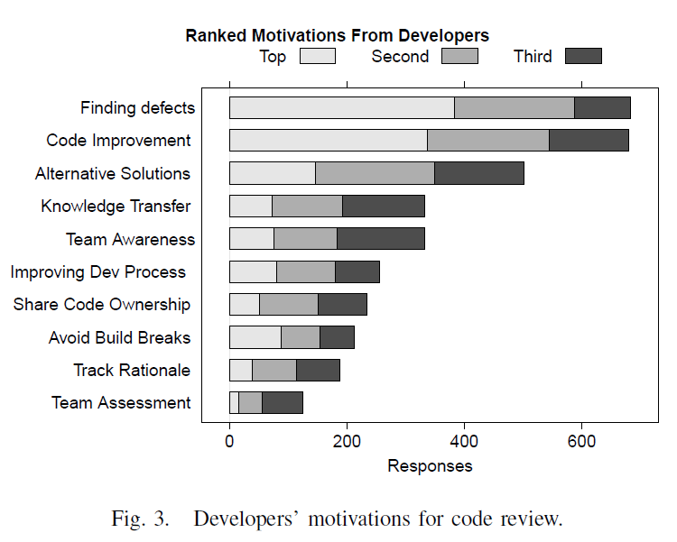
What is Code Review
Performing human inspection of the source code by developers other than the author of the code.
Apart from finding bugs, code review has many other purposes: code improvement, alternative solutions, knowledge transfer, team building, and so on.
[1]

Slide 5
Home Reading
[1] Alberto Bacchelli and Christian Bird. 2013. Expectations, outcomes, and challenges of modern code review. In Proceedings of the 2013 International Conference on Software Engineering (ICSE '13). IEEE Press, Piscataway, NJ, USA, 712-721.
https://ieeexplore.ieee.org/document/6606617/
You can get a copy of the article using a computer in CityU.

Slide 6
Different Levels of Formality
Code walkthrough
informal meeting where the programmer leads the review team through his/her code, and the reviewers try to identify faults
More effective if the programmer and reviewer are not the same person
Sometimes, integrate with Pair Programming
Code Inspection
Formal meeting
Effective to find bugs in code.
Home Reading: https://en.wikipedia.org/wiki/Fagan_inspection
Modern Code Review

Slide 7
Code walkthrough:
isWin() aims to do what and so ….
Main() performs “these” in these few lines and “those” in those lines

Slide 8
Code Walkthrough
Result from an old paper [21]
Similar to testing in effectiveness for finding bugs
But code walkthrough requires more human effort: less effective
In recent years, developers have become aware of technical debts (non-bug issues), where testing is ineffective in addressing them.
E.g., readability, reusability, maintainability, etc.
The remote collaboration raised from the needs of “work from home” makes code walkthrough by visually impaired developers join code walkthroughs remotely. Some strategies proposed are shown on the next slide.

Slide 9
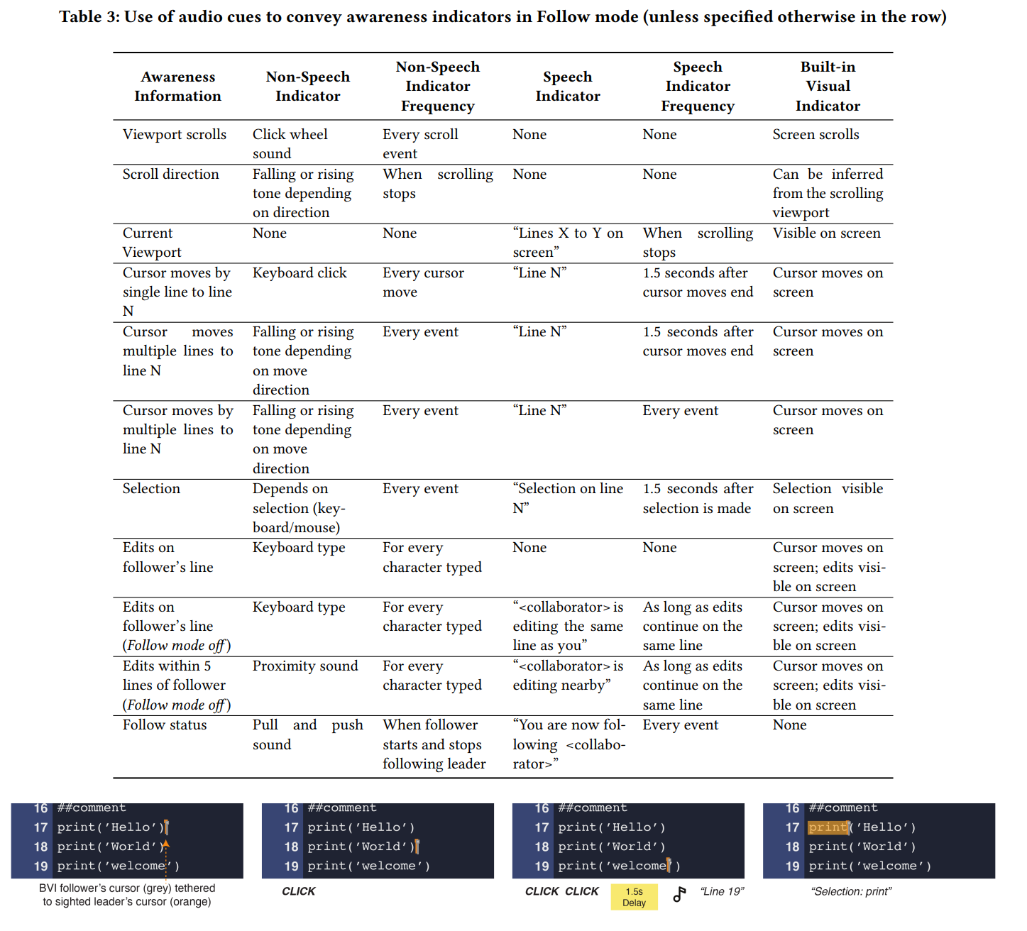
e.g., Code Walkthrough [22]

Slide 10
Code Inspection [6]
Is a highly structured and formal process of review
Sometimes called static testing in companies
Effective to find bugs and spot process improvements
Decreasingly popular
Things to check
Efficiency of algorithm
Logics and correctness of code
E.g., control flow and data-flow, I/O format, and order, parameters and return value types and order, etc
Comments and consistency with code
Develop your own checklist

Slide 11
Main Ideas in Code Inspection [6]
Main Ideas
Pre-meeting: Authors educate reviewers, and reviewers read/question the code from a testing angle.
In-meeting: Walk through the code (by code author) with reviewers and check against checklists. Answer questions and resolve ambiguity. Each reviewer has a predefined role assigned pre-meeting. (e.g., a focal area to check)
Reviewers “execute” the code in their heads
Post-meeting: Authors follow up and rectify the code. The moderator verifies the required corrective actions taken properly.
Characteristics
Formal, synchronous, check code, tool support is secondary, heavy-weighted

Slide 12
Code Inspection: In-Class Activity MCR-1
Form a group of at least 6 (neither too small nor too large is useful)
Author A of the code: 1 student
Moderator M of the meeting: 1 student leader (non-author)
Reviewer R: 1 x syntax, 1 x logics, 1 x input/output (and the environment)
On an online shared Word document, write down the role of each student in the activity
Keep the document and the corrected code for later use for our Exercise MCR-2
Timeline (in minutes)
00-10: A studies the code C (see the next slide); M finds a meeting place (virtually)
10-20: A educates R on C; M prepares a checklist on C
20-30: each R reviews C privately; M calls for a meeting at time-point 29
30-45: code walkthrough, Q&A (All); M jots down notes N in the Word document
45-50: M submits N to Canvas; A corrects C to resolve all the problems in N
50-51: M and A together check the corrected C against N
52: A stores the corrected C (as code C1) if M agrees
Make sure each group keeps C1 as we need it for the next in-class activity MCR-2

Slide 13
Notes:
Logic problems:
+ no input validation
+ memory corruption when i = 3 or j=3 is inputted when game[i]j] is assigned with a value.
+ missing tie message sometimes when tie case is i<>3.
Code Smells:
+ Text for Player 1 and Player 2 are duplicated.
+ variables player1 and player2 should be used when assigning values to game[i][j].
When needing to be compiled online in C++ 14. use the following version:
https://www.onlinegdb.com/online_c++_compiler
http://cpp.sh/
---------------------
#include <iostream>
#include <stdio.h>
#include <string>
bool isWin(char game[3][3]){
bool win = false;
if (game[0][0] == game[0][1] && game[0][1] == game[0][2] && (game[0][0] == 'X' || game[0][0] == 'O')) win = true;
if (game[1][0] == game[1][1] && game[1][1] == game[1][2] && (game[1][0] == 'X' || game[1][0] == 'O')) win = true;
if (game[2][0] == game[2][1] && game[2][1] == game[2][2] && (game[2][0] == 'X' || game[2][0] == 'O')) win = true;
// column
if (game[0][0] == game[1][0] && game[1][0] == game[2][0] && (game[0][0] == 'X' || game[0][0] == 'O')) win = true;
if (game[0][1] == game[1][1] && game[1][1] == game[2][1] && (game[0][1] == 'X' || game[0][1] == 'O')) win = true;
if (game[0][2] == game[1][2] && game[1][2] == game[2][2] && (game[0][2] == 'X' || game[0][2] == 'O')) win = true;
// diagonal
if (game[0][0] == game[1][1] && game[1][1] == game[2][2] && (game[0][0] == 'X' || game[0][0] == 'O')) win = true;
if (game[0][2] == game[1][1] && game[1][1] == game[2][0] && (game[0][2] == 'X' || game[0][2] == 'O')) win = true;
return win;
}
int main(){
int i, j;
char game[3][3] = {' '}; // Tic-tac-toe
char player1 = 'X';
char player2 = 'O';
bool turn = true; // false for player 1's turn, true for player 2's turn. Player 1 first.
std::cout << "X = Player 1" << std::endl << "O = Player 2" << std::endl;
for (int n=0; n<9; n++){
turn = !turn; // use the not-operator to change true to false or false to true.
if (turn == false)
std::cout << "Player 1: ";
else
std::cout << "Player 2: ";
std::cout << "Which cell to mark? i:[1..3], j:[1..3]: ";
std::cin >> i >> j;
if (turn == false)
game[i][j] = 'X';
else
game[i][j] = 'O';
if (isWin(game)){
std::cout << "Win!" << std::endl;
break; // need to terminate the problem
}
}
if (i==3) // all celles with i=0 to 2 have been inputted above but no winner yet
std::cout << "Tie!" << std::endl;
// show the game to console
std::cout << game[0][0] << " " << game[0][1] << " " << game[0][2] << std::endl;
std::cout << game[1][0] << " " << game[1][1] << " " << game[1][2] << std::endl;
std::cout << game[2][0] << " " << game[2][1] << " " << game[2][2] << std::endl;
return 1;
}

Slide 14
MCR-1: Materials Authors to Pass to Reviewers
Console screen:
Inputs are underlined
X = Player 1 O = Player 2 Player 1: Which cell to mark? i:[0..2], j:[0..2]: 0 2 Player 2: Which cell to mark? i:[0..2], j:[0..2]: 0 0 Player 1: Which cell to mark? i:[0..2], j:[0..2]: 2 0 Player 2: Which cell to mark? i:[0..2], j:[0..2]: 1 1 Player 1: Which cell to mark? i:[0..2], j:[0..2]: 2 2 Player 2: Which cell to mark? i:[0..2], j:[0..2]: 1 2 Player 1: Which cell to mark? i:[0..2], j:[0..2]: 2 1 Win! O X O O X X X

Slide 15
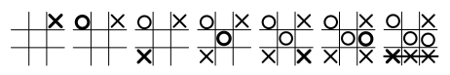
MCR-1: Authors’ Private Materials
Tic-tac-toe (過三關) is a game involving two users. In the game, there is a 3x3 grid. The grid is initially empty. Each cell can place with the character ‘X’, the character ‘O’, or be left empty. When there is a row, a column or a diagonal all filling with the same character, then the user Wins. For instance, the diagram shows that the bottom row is all filled with the character ‘X’. So, the user for ‘X’ wins the game.
The written program is to allow two players (Player 1 and Player 2) to input the coordinates of their chosen cells in turn. After receiving each input, the program determines whether there is any winner, and if there is a winner, it outputs the message “Win!”. If there is no winner after all the 9 cells filled, output “Tie!”. Right after showing the message “Win!” or “Tie!”, it shows the whole tic-tac-toe grid and terminates the game.

Slide 16
Modern Code Review (MCR)
MCR is a lightweight and tool-based code review of code change (not the whole piece of code!)
is the norm for many software development projects
Characteristics of MCR
Informal; tool-based logistics; asynchronous; and focused on reviewing code changes; lighter weight than code inspection
Main Ideas
Author A makes a patch P on a code block C to address some problems and sends the patch P via e-channel (e.g., email, WhatsApp, WeChat, or GitHub tool) to a set of reviewers R
Each reviewer R evaluates P: deems P good, requests changes on P, or rejects P
Author A commits P; post-commit reviewer by other Rs possible.
Authors and reviewers exchange ideas, find bugs, and discuss alternative solutions to better design the structure of a submitted code change.
Notes:
Patch: The diff file of two pieces of code
See the example: https://www.cyberciti.biz/faq/appy-patch-file-using-patch-command/

Slide 17
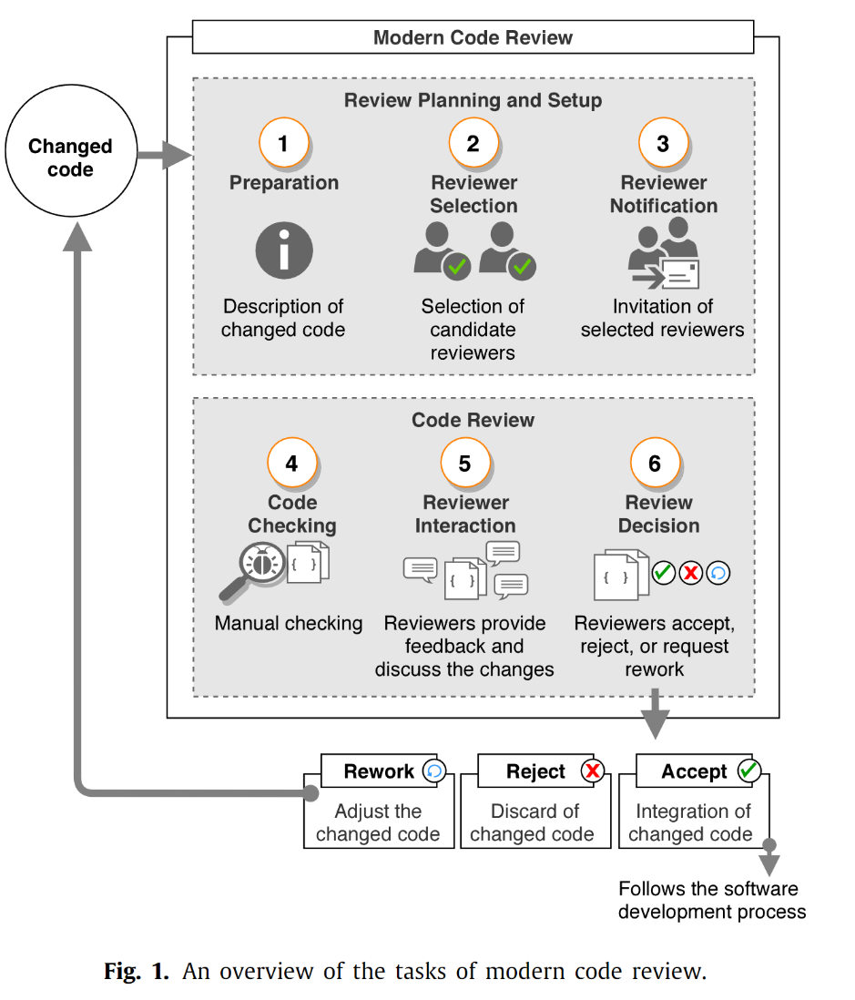
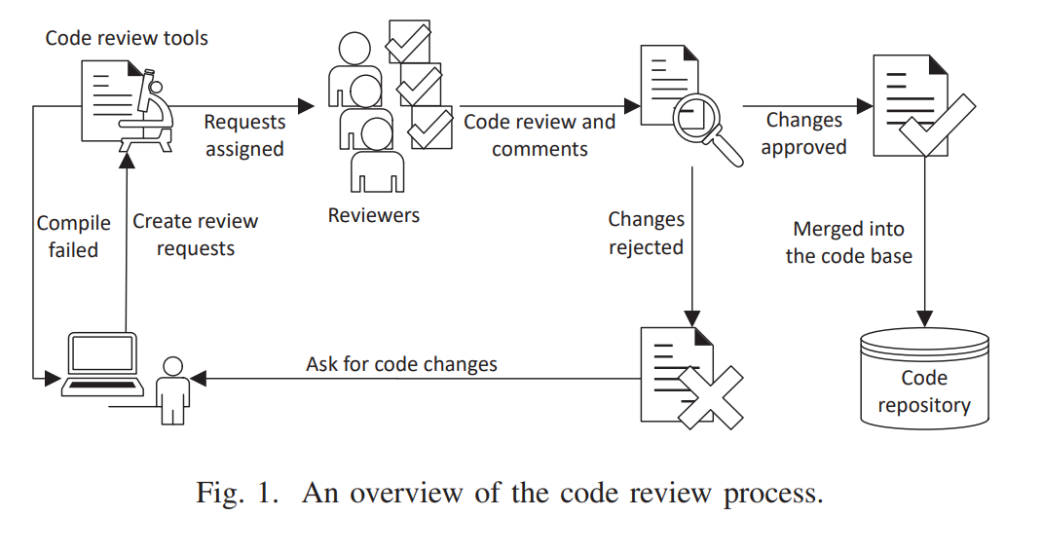
MCR Process
[20]
[19]

Slide 18
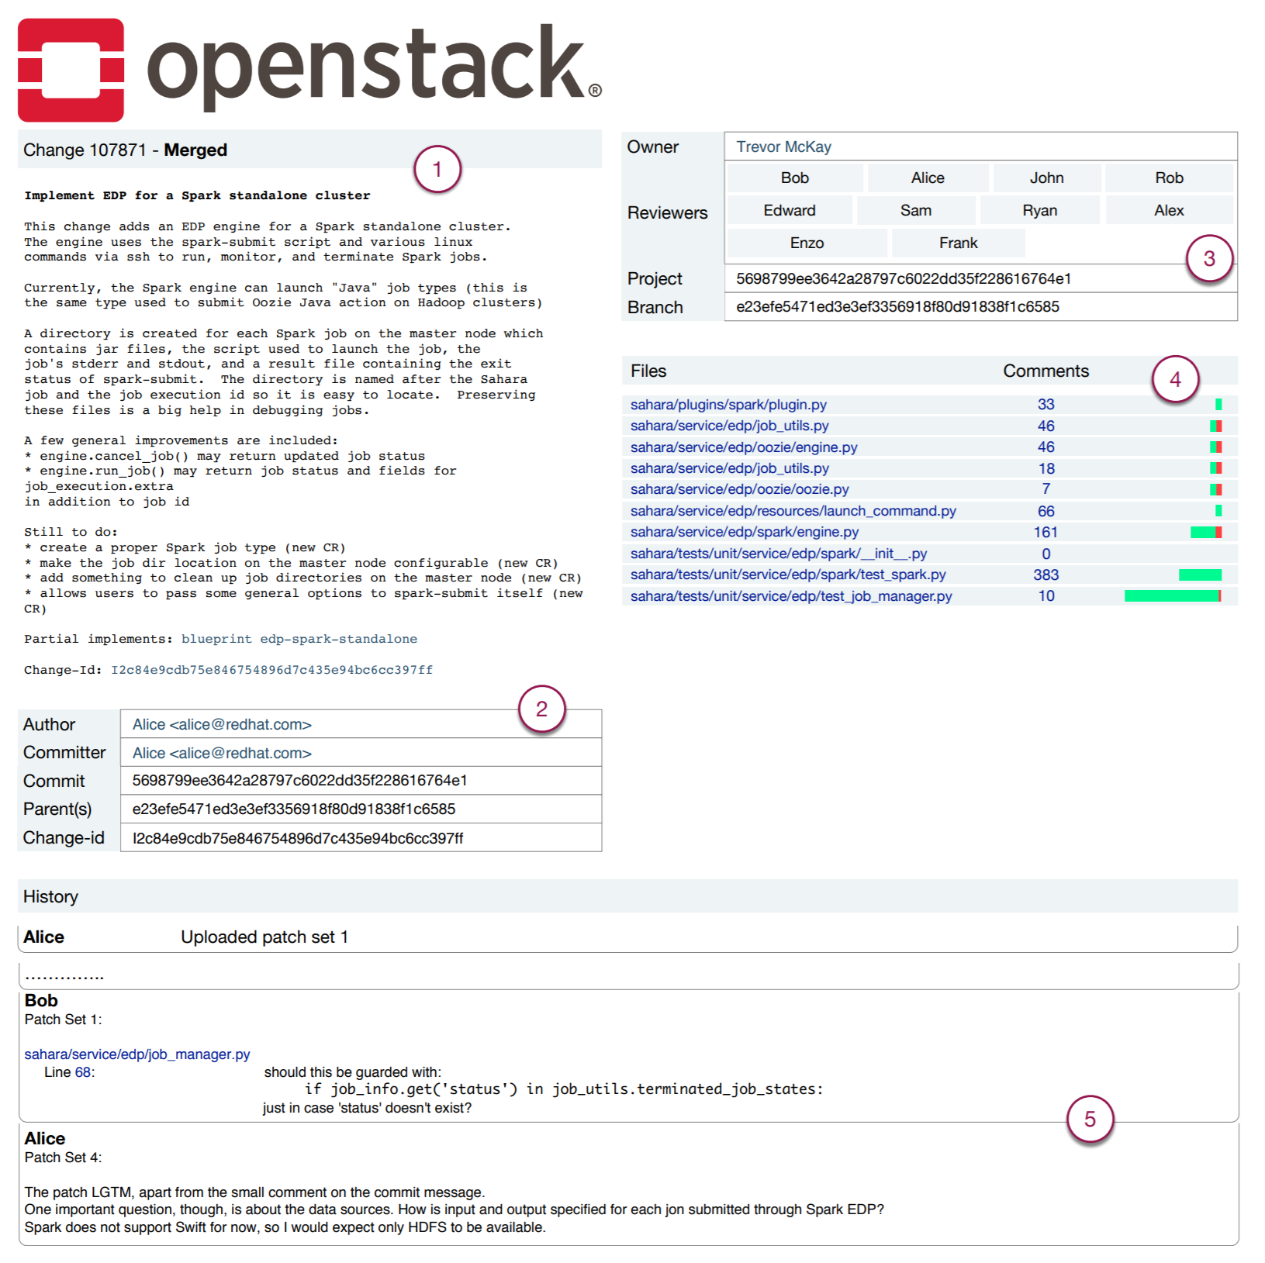
Example [12]
See next slide

Slide 19
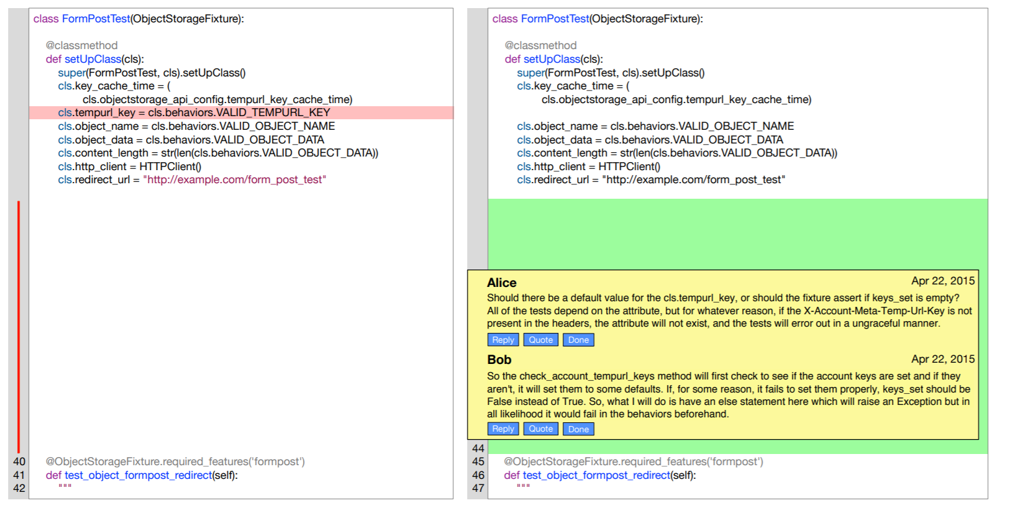
Example [12]
Expanding a file in the change

Slide 20

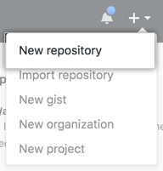
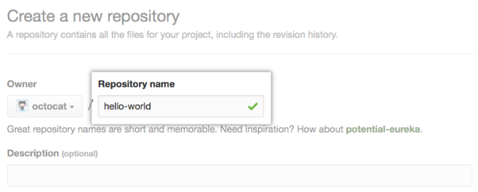
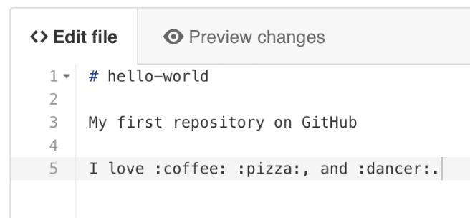
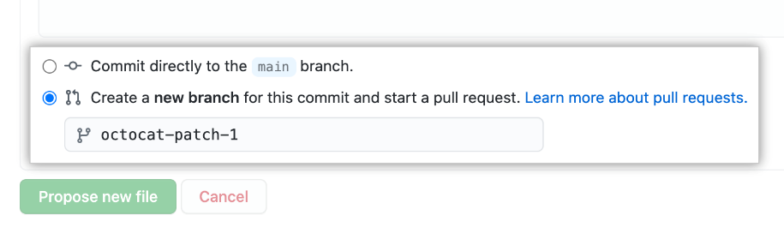
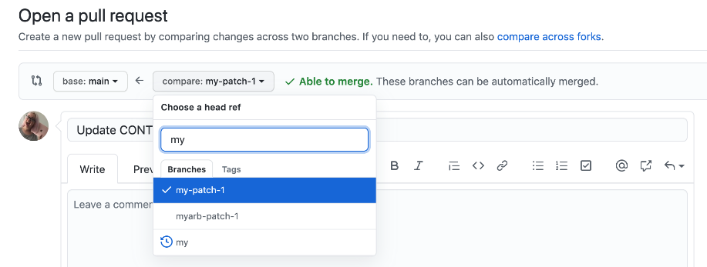
Example [17]
1. In the upper-right corner of any page, use the drop-down menu, and select New repository.
2. Type a short, memorable name for your repository. For example, "hello-world".
3. make any changes you need to the file.
5. Create a pull request to propose and collaborate on changes to a repository.
4. decide whether to add your commit to the current branch or to a new branch.

Slide 21
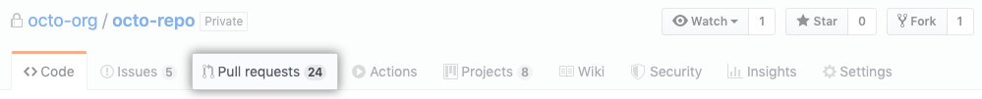
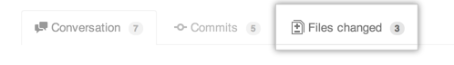
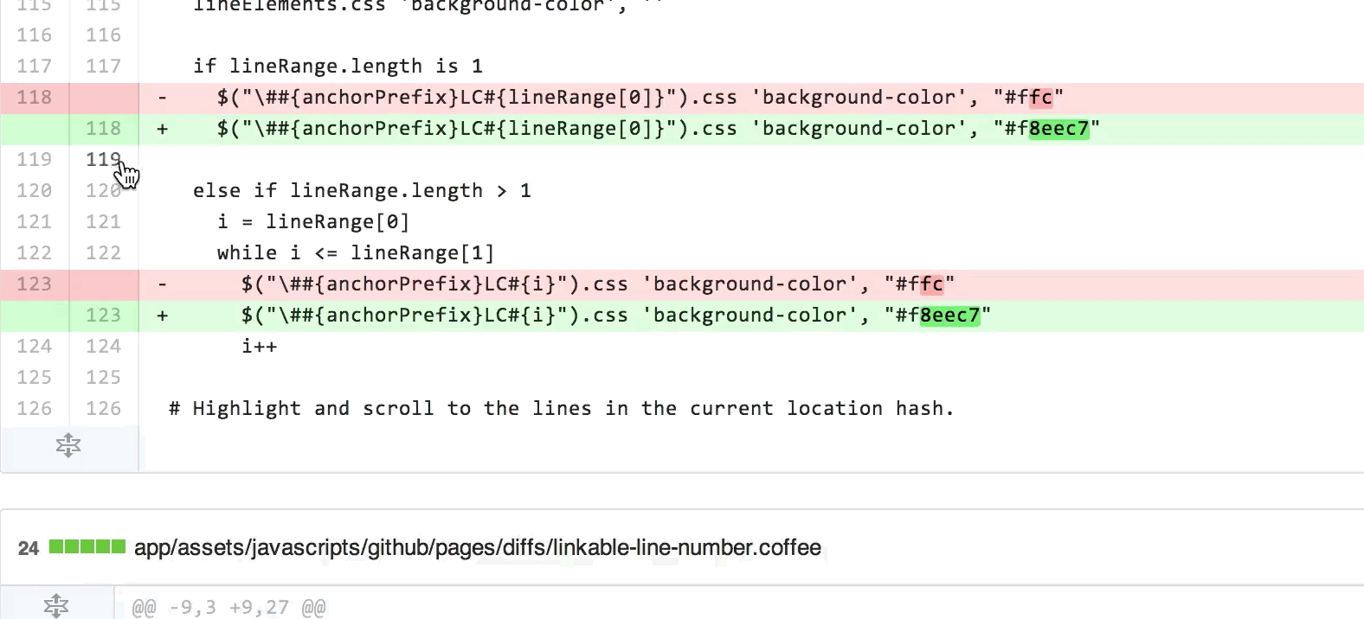
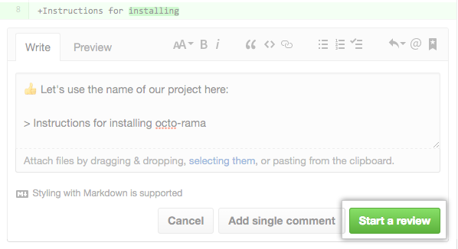
Example [17]
6. Hover over the line of code where you'd like to add a comment and click the blue comment icon. To add a comment on multiple lines, click and drag to select the range of lines, then click the blue comment icon.
7. When you're done, click Start a review. If you have already started a review, you can click Add review comment.

Slide 22
Characteristics of Modern Code Review
Informal
Ad hoc group of reviewers without predefined roles, and the review process does not follow a formal procedure
Tool-based logistics
Email, WhatsApp, and WeChat are popular.
Open-source tools: GitHub, Gerrit (for Git), ReviewBoard, Phabricator
Asynchronous
Authors and reviewers need not engage in the same task simultaneously (but not extensively delayed)
Focus the review on the patch (code change, the delta)
Notes:
Gerrit: https://www.gerritcodereview.com/
ReviewBoard: https://www.reviewboard.org/
Phabricator https://www.phacility.com/

Slide 23
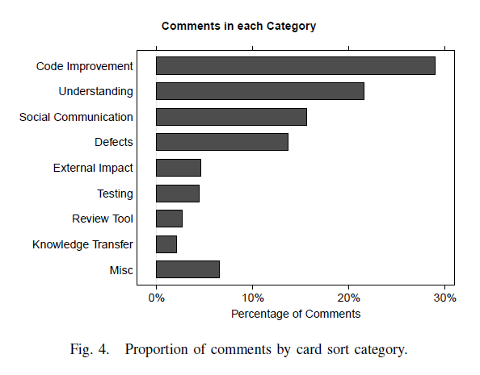
Purposes of Reviews/Comments/Posts [1]
4 Major Areas

Slide 24
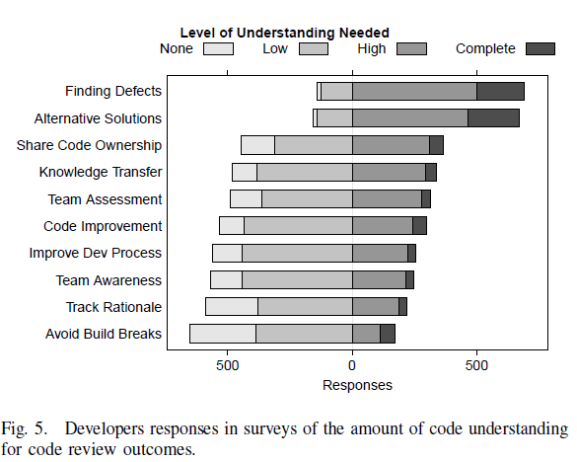
Understanding the Code for What? [1]
Toward technical
Toward managerial

Slide 25
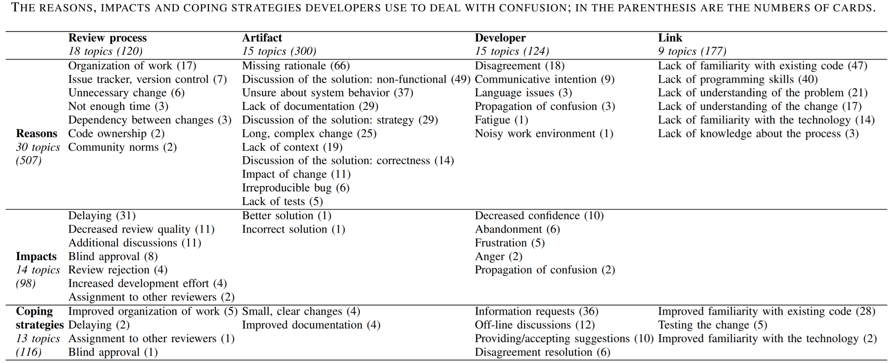
Strategy to Deal with Confusion [14]
No particularly good strategy

Slide 26
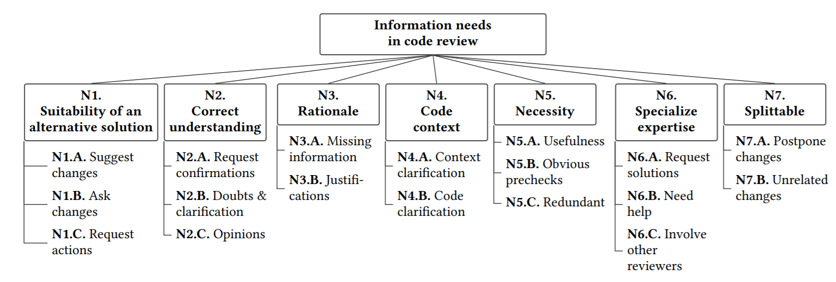
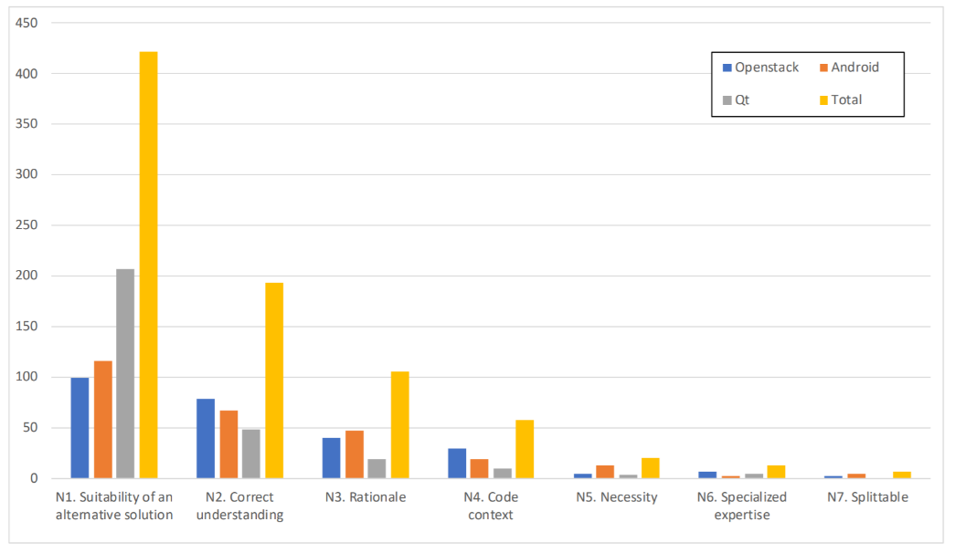
What Information is Needed by Reviewers? [12]

Slide 27
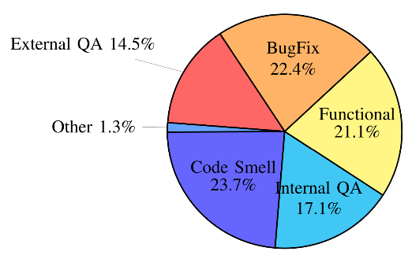
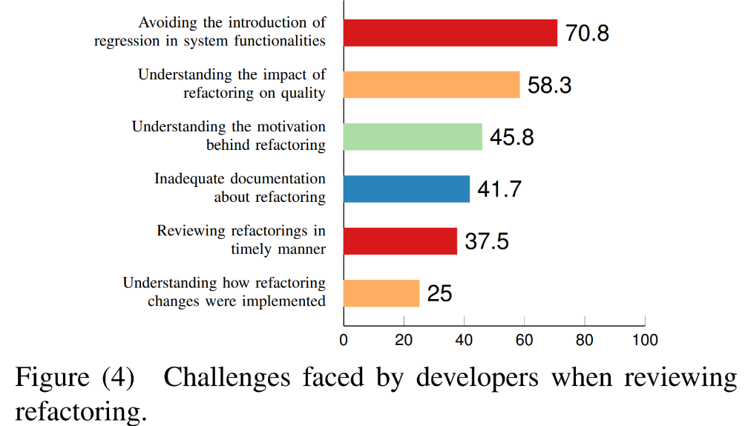
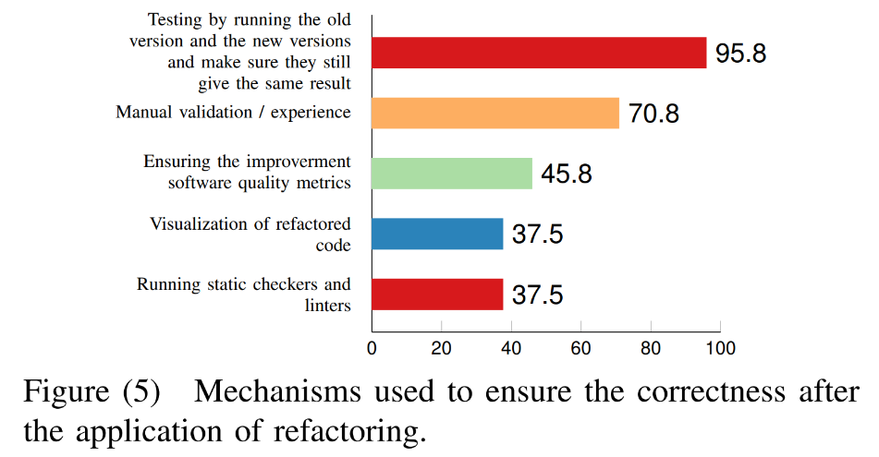
How about a review patch is for code refactoring?
Industrial case study in Xerox [23]
“Coping with poor design and coding style is the main driver for developers to apply refactoring in their code changes. Yet, functional changes and bug fixing activities often trigger developers to refactor their code as well.”

Slide 28
How about Knowledge Transfer?
Does conducting more rounds of MCR improve the code quality of a developer?
Unfortunately, there is no evident yet both within the same project and across multiple projects. [16]
Then, let’s look at the MCR in big tech companies. See the next few slides.

Slide 29
MCR Best Practices [1, 3, 7]
peer review follows a lightweight, flexible process
Reviews happen early (before a change is committed), in time, and frequently
Reviewers have a prior knowledge of the context and the code to complete reviews quicker and provide more valuable feedback to the authors
Change sizes are small
Small numbers of reviewers (1 to 5 reviewers)
Read informal posts and comments on the code and patch
Review is not just to find bugs at group-level: problem solving (solution development), code readability and maintainability, following the norm (of the belonging company), accidence prevention, gate-keeping (recall the role of moderator in code inspection?)

Slide 30
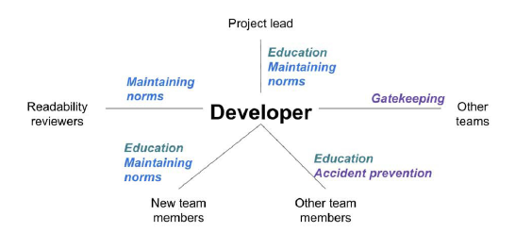
MCR Best Practices [3]
The above diagram shows the relationships between Developer (i.e., Author) and Reviewers in a code project in Google

Slide 31
MCR Best Practices in Google [3]
Suggesting Reviewers: ask persons who can serve as reviewers in turn and in a round-robin manner.
Do not consistently overload the best persons in the team
Perform code analysis to supplement human reviewers
Apply style checkers, code checkers
E.g., Checkstyle for Java
Review frequency: 4 hours of review (and 4 reviews) per week (median)
Review speed: authors wait for 1-5 hours
Changed code size: 1 line of code (~10%), one file (~30%), fewer than 10 files (~90%).
Notes:
Java resources; https://www.romexsoft.com/blog/improve-java-code-quality/

Slide 32
MCR Best Practices
Reviewer candidates?
Code owner
Developers who made previous changes on the code
Developers who develop the code before (e.g., in producing the code through pair programming)
Experienced reviewers
Developers who develop similar features of the changed fragments in some other code
…

Slide 33
MCR Issues
Review Quality and Code Size
Reviews on code with higher complexity get fewer discussions and feedback.
Code with fewer review feedbacks will encounter more post-release bugs
Distance
Causing delay in the review process or leading to misunderstanding
Aspect 1: Geographical issue
Large physical distance between authors and reviewers
Aspect 2: Organization issue
Reviewers from different teams or taking different roles
Social Interaction
Tone: comments with negative tones are less useful
Power: ask another person to change their comments. Authors unhappy
Context
Misunderstanding due to mismatched expectations on the code change (e.g., nice to have vs. urgent fix, full solution vs. high level sketch)

Slide 34
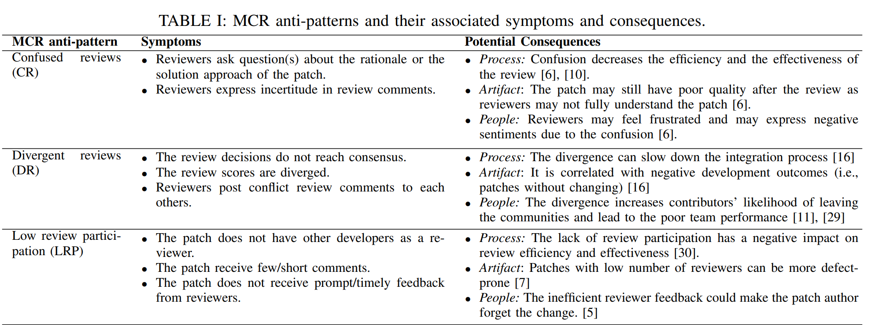
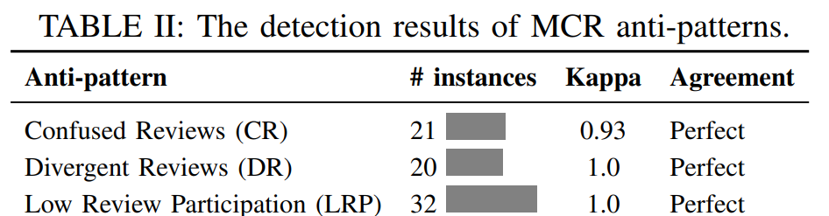
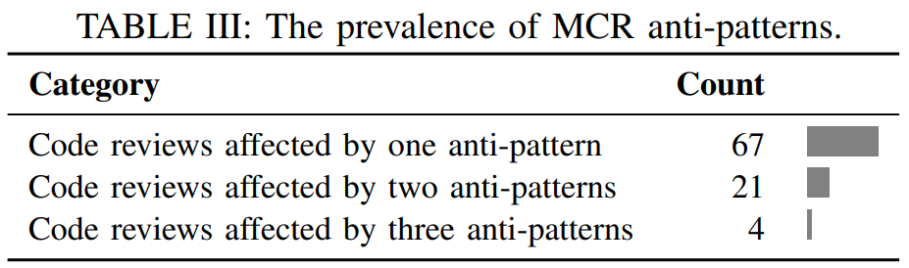
Other Issues in Ineffective MCR: Anti-Pattern in MCR [18]

Slide 35
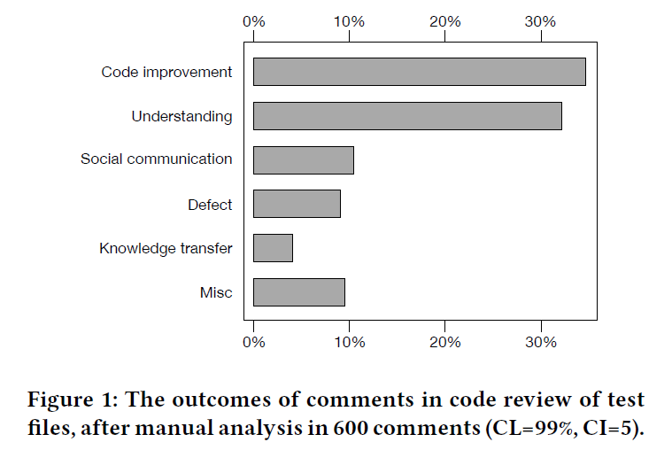
Should We Review Test Code too?
The simple answer is “yes”, but on different focuses and less often (and review with the production code)
2 Major Areas
Question: improving and understanding what kinds of code?
[4]

Slide 36
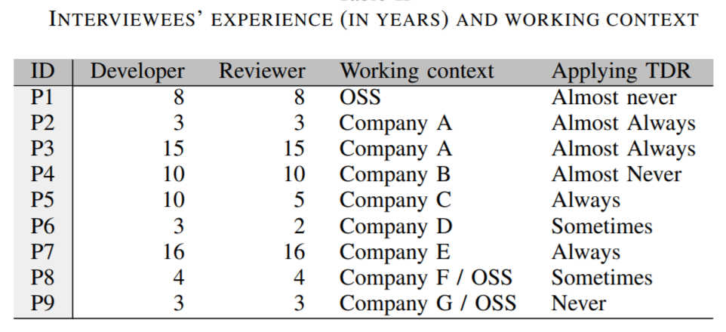
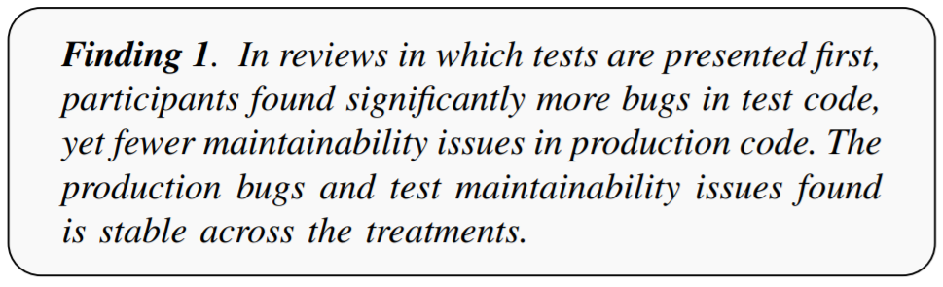
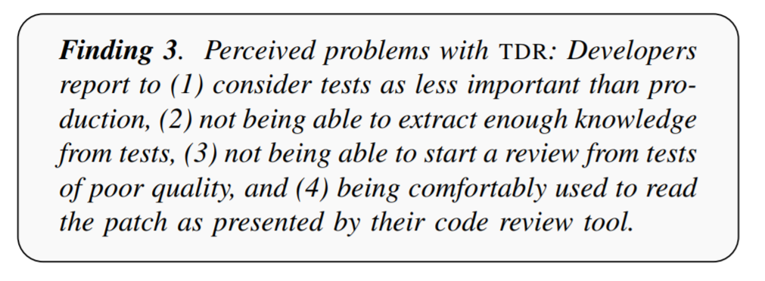
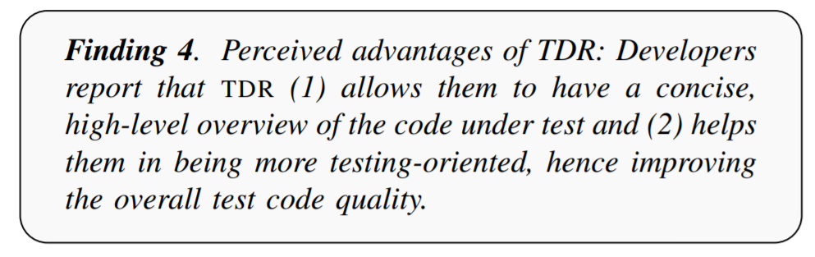
Understanding and Improving What Kinds of Code by Reviewing Test Code? [15]
Conducted by German researchers from 92 developers.

Slide 37
Modern Code Review: In-Class Activity MCR-2
https://github.com/marketplace/category/code-review
Form a group of students
Author A of the code: 1 student
Reviewer R: no pre-defined role
Agree among members on the tool for review (we use Github in the tutorial)
Timeline (in minutes)
00-15: A prepares the patch P for the code C on the Github platform, along with some explanation of the patch P, and notifies the groupmate via the e-channel
15-25: R reviews P and posts comments on GitHub. Also, notify via the e-channel when finishing the review
15-25: A answers issues and provides clarifications made by R and revises patch P’ iteratively.
25-30: R approves P, and A applies the final patch P’ get the final corrected code C2
30: A submits the corrected C2 with comments (images or link to the GitHub repository?) to Canvas Discussion for peer sharing in addition to using C2 as a commit

Slide 38
Self-Study Home Exercise [no submission is needed]
Read Ref [1]
Find out the methods to increase team awareness
On page 5, a summary from a senior developer stated five benefits of code review. What are the benefits?
On pages 5-6, what can a team do to increase knowledge transfer?
On page 7, what are the stated problems if the quality of review code is slow?
On page 9, what are the recommendations? Do you agree?
Read Ref [5]
On slide 23, what are the key features of a tool to support code reviews that the author of the Slide Presentation believes the tool to have?
Self-Reflection
If your company asks you to incorporate MCR into your project but without providing addition budget ($), what and how you implement MCR for it?
Distance is a major MCR issue. How does a team (with members located in different cities and probably with different culture backgrounds) do MCR?

Slide 39
AI-assisted MCR
AI-Assisted Assessment of Coding Practices in Modern Code Review in Google [25]
Code Review with GitHub Copilot
https://docs.github.com/en/copilot/how-tos/use-copilot-agents/request-a-code-review/use-code-review

Slide 40
References and Resources
Alberto Bacchelli and Christian Bird. 2013. Expectations, outcomes, and challenges of modern code review. In Proceedings of the 2013 International Conference on Software Engineering (ICSE '13). IEEE Press, Piscataway, NJ, USA, 712-721.
Christopher Thompson and David Wagner. 2017. A Large-Scale Study of Modern Code Review and Security in Open Source Projects. In Proceedings of the 13th International Conference on Predictive Models and Data Analytics in Software Engineering (PROMISE). ACM, New York, NY, USA, 83-92. DOI: https://doi.org/10.1145/3127005.3127014
Code review appears not to be a good choice for identifying security bugs
Caitlin Sadowski, Emma Söderberg, Luke Church, Michal Sipko, and Alberto Bacchelli. 2018. Modern code review: a case study at google. In Proceedings of the 40th International Conference on Software Engineering: Software Engineering in Practice (ICSE-SEIP '18). ACM, New York, NY, USA, 181-190. DOI: https://doi.org/10.1145/3183519.3183525
Davide Spadini, Maurício Aniche, Margaret-Anne Storey, Magiel Bruntink, and Alberto Bacchelli. 2018. When testing meets code review: why and how developers review tests. In Proceedings of the 40th International Conference on Software Engineering (ICSE '18). ACM, New York, NY, USA, 677-687. DOI: https://doi.org/10.1145/3180155.3180192
SlideShare: https://www.slideshare.net/excellaco/modern-code-review

Slide 41
References and Resources
M. E. Fagan. 1976. Design and code inspections to reduce errors in program development. IBM System Journal, 15, 3 (September 1976), 182-211. DOI=http://dx.doi.org/10.1147/sj.153.0182
Peter C. Rigby and Christian Bird. 2013. Convergent contemporary software peer review practices. In Proceedings of the 2013 9th Joint Meeting on Foundations of Software Engineering (ESEC/FSE 2013). ACM, New York, NY, USA, 202-212. DOI: https://doi.org/10.1145/2491411.2491444
Wikipedia. List of tools for code review. https://en.wikipedia.org/wiki/List_of_tools_for_code_review . 2018
Gerrit: https://www.gerritcodereview.com/ Last access 2021
ReviewBoard: https://www.reviewboard.org/ Last access 2021
Phabricator https://www.phacility.com/ Last access 2021
Luca Pascarella, Davide Spadini, Fabio Palomba, Magiel Bruntink, and Alberto Bacchelli. 2018. Information Needs in Contemporary Code Review. Proc. ACM Hum.-Comput. Interact. 2, CSCW, Article 135 (November 2018), 27 pages. DOI: https://doi.org/10.1145/3274404
Achyudh Ram, Anand Ashok Sawant, Marco Castelluccio, and Alberto Bacchelli. 2018. What makes a code change easier to review: an empirical investigation on code change reviewability. In Proceedings of the 2018 26th ACM Joint Meeting on European Software Engineering Conference and Symposium on the Foundations of Software Engineering (ESEC/FSE 2018). 201-212. DOI: https://doi.org/10.1145/3236024.3236080
Felipe Ebert, Fernando Castor, Nicole Novielli, Alexander Serebrenik: Confusion in Code Reviews: Reasons, Impacts, and Coping Strategies. In Proceedings of 26th IEEE International Conference on Software Analysis, Evolution and Reengineering, SANER 2019. 49-60. https://doi.org/10.1109/SANER.2019.8668024

Slide 42
References and Resources
Davide Spadini, Fabio Palomba, Tobias Baum, Stefan Hanenberg, Magiel Bruntink, and Alberto Bacchelli. 2019. Test-driven code review: an empirical study. In Proceedings of the 41st International Conference on Software Engineering (ICSE '19). IEEE Press, 1061–1072. DOI:https://doi.org/10.1109/ICSE.2019.00110
Maria Caulo, Bin Lin, Gabriele Bavota, Giuseppe Scanniello, Michele Lanza. Knowledge Transfer in Modern Code Review. In Proceedings of 28th IEEE/ACM International Conference on Program Comprehension (ICPC 2020). https://binlin.info/downloads/Caulo2020a.pdf
Github Docs: https://docs.github.com/en/github Last access 2021
Moataz Chouchen, Ali Ouni, Raula Gaikovina Kula, Dong Wang, Patanamon Thongtanunam, Mohamed Wiem Mkaouer, Kenichi Matsumoto. 2021. Anti-patterns in Modern Code Review: Symptoms and Prevalence. SANDER 2021, pp 531-535, 2021.
Nicole Davila, Ingrid Nunes. A systematic literature review and taxonomy of modern code review. Journal of Systems and Software 177 (2021): article 110951 . https://doi.org/10.1016/j.jss.2021.110951
Ruiyin Li, Mohamed Soliman, Peng Liang, Paris Avgeriou. Symptoms of Architecture Erosion in Code Reviews: A Study of Two OpenStack Projects. 2022 IEEE 19th International Conference on Software Architecture (ICSA 2022), pp 24-35, 2022.
Glenford J. Myers. A Controlled Experiment in Program Testing and Code Walkthroughs Inspections. CACM, 1978 21(9): 760-768, 1979.
Venkatesh Potluri, Maulishree Pandey, Andrew Begel, Michael Barnett, Scott Reitherman: CodeWalk: Facilitating Shared Awareness in Mixed-Ability Collaborative Software Development. ASSETS 2022: 20:1-20:16

Slide 43
References and Resources
Eman Abdullah AlOmar, Hussein Alrubaye, Mohamed Wiem Mkaouer, Ali Ouni, Marouane Kessentini: Refactoring Practices in the Context of Modern Code Review: An Industrial Case Study at Xerox. ICSE (SEIP) 2021: 348-357
Manushree Vijayvergiya, Małgorzata Salawa, Ivan Budiselić, Dan Zheng, Pascal Lamblin, Marko Ivanković, Juanjo Carin, Mateusz Lewko, Jovan Andonov, Goran Petrović, Daniel Tarlow, Petros Maniatis, and René Just. 2024. AI-Assisted Assessment of Coding Practices in Modern Code Review. In Proceedings of the 1st ACM International Conference on AI-Powered Software (AIware 2024). Association for Computing Machinery, New York, NY, USA, 85–93. https://doi.org/10.1145/3664646.3665664

